Slide 1
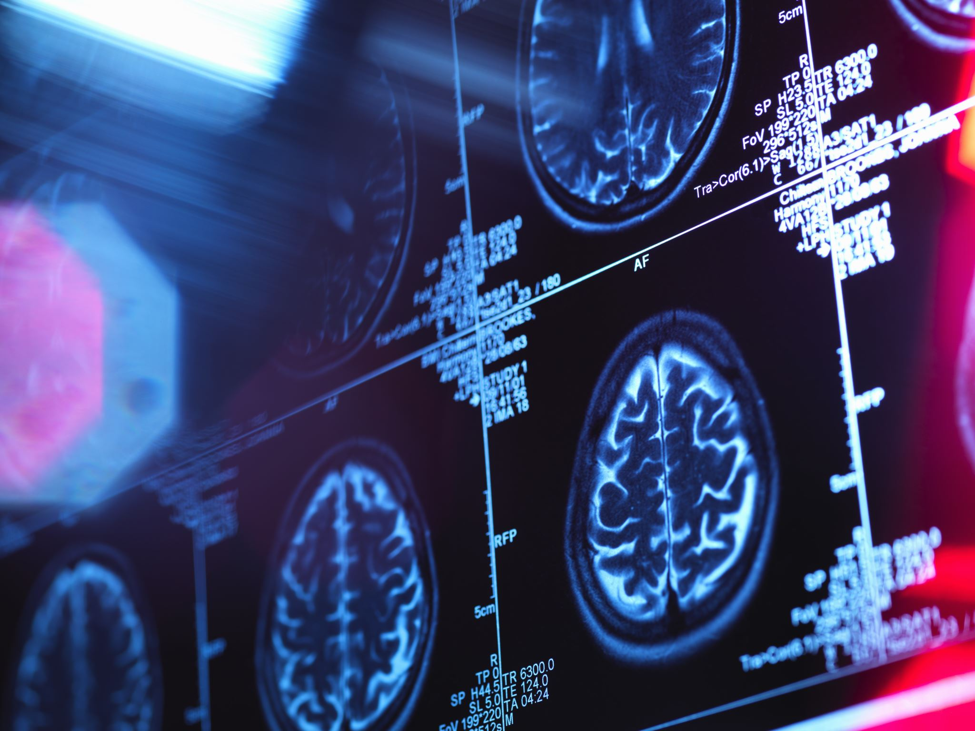
TEAM 4 PROJECT PRESENTAION
RUTHU GANDAL SHANKARE GOWDA
NOAH FRANCIS BRITT
AKASH VENUGOPAL

Slide 2
Problem statement
In order to protect patient privacy and comply with ethical guidelines, researchers commonly employ skull-stripping techniques to extract only the relevant brain image voxels and remove any data related to the skull structure and facial features from the raw 3D MRI images prior to data sharing.
One objective of skull-stripping in MRI imaging is to ensure that facial features are removed to a degree that would prevent identification of the individual based on the remaining features in the stripped image. Additionally, it is important to assess whether any unintended removal of brain voxels occurred during the skull-stripping process, as this could result in the loss of crucial brain information.

Slide 3
DEEP NEURAL NETWORKS FOR CLASSIFICATION
Convolutional Neural Networks (CNN): is a type of deep neural network that is commonly used for image classification and other computer vision tasks.
Recurrent Neural Network (RNN) is a type of deep neural network that is designed to handle sequential data, such as time-series data or natural language text.
Generative Adversarial Network (GAN): is a type of neural network that is used for unsupervised learning tasks, such as image generation or image-to-image translation, Style transfer, Anomaly detection and more.

Slide 4
WHY Convolution neural network (CNN)?
CNN is a type of deep neural network that is commonly used for image classification. CNNs are specifically designed to capture spatial relationships and patterns within input data, such as images, by exploiting the local correlation between neighboring data points.
CNNs consists of multiple convolutional and pooling layers, with each layer learning increasingly complex features from the input data. The output of the final convolutional layer is typically flattened and passed through one or more fully connected layers.The final layer of the network typically uses a softmax activation function to produce a probability distribution over the possible output classes.

Slide 5
WHY Convolution neural network (CNN)? (cont.)
Advantages of CNN over other neural networks
They can efficiently extract spatial features and patterns in the data, and can learn hierarchical representations of objects or patterns in the data.
CNN can process their input data in parallel, as parallel processing is helpful in real time over sequential processing.
CNNs are able to detect and recognize features in different locations within an image, regardless of their position or orientation. This property is known as translation invariance.

Slide 6
Background work
Conventional and Deep Learning Methods for Skull Stripping in Brain MRI
Hafiz Zia Ur Rehman, Hyunho Hwang and Sungon Lee
DESIGN AND DEVELOPMENT OF DYSLEXIA DATA CONSORTIUM
Thesis Presented by Roshan Bhandari

Slide 7
data
We were provided a large dataset of 2,060 skull-stripped MRI scans, which were then placed into four categories:
Containing personally identifiable information without any loss of brain features
Not containing personally identifiable information but with a loss of brain features
Not containing personally identifiable information with no loss of brain features.
Containing personally information and containing loss of brain features
Each scan in the dataset consisted of images sized 256x256 pixels with varying depths, with the maximum depth being 150.
The dataset was provided in the form of a folder containing compressed .nii files, which is a file extension used for storing MRI scans.
The name of each file was given in a labels CSV

Slide 8
IMPLEMENTATION
To build our dataset and model, we utilized the popular python library, Keras and Tensorflow.
Additionally, we employed the nibabel python library to extract data from each .nii file.
Furthermore, we utilized the matplotlib library to generate charts and images to assist us in visualizing the data and results obtained from our script.

Slide 9
Data preprocessing
In preparation for building the model, we first constructed the dataset.
To accomplish this, we split the scans into two sets: 80% for training data and 20% for testing data.
We ensured that the file names from the label file matched the data being read in by creating an array of images paired with a corresponding array of class labels.
The class labels were assigned the values of 0, 1, 2 and 3 to represent the previously discussed four categories.

Slide 10
Data preprocessing (cont.)
After attempting to use the full image size and depth, Tensorflow couldn’t handle a large model with sufficient batch size
To solve this, we realized we could reach high accuracies even if we reduced input sizes
Following a range of different filtering methods, we decided on reducing each 2D image to 128x128, and including 75 of the 2D scans to form a 3D image
This would allow us to use a stronger model and stronger batch size while also keeping a high quality of inputted data

Slide 11
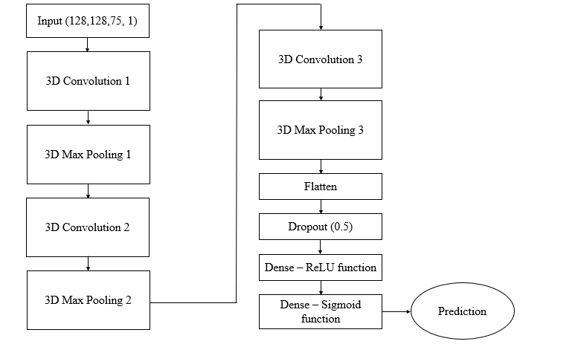
Our model
Our model consisted of three relu-activation convolutional layers, with the first layer having 32 filters and the second layer having 32 filters, and the third having 16.
Following each convolutional layer, we included a pooling layer to reduce the dimension of the data.
After the input data passed through the convolutional layers, it was flattened and fed through a dense network of 16 layers
Finally, a Dropout filter with an intensity of 0.5 was used to prevent convergence on the most common value
The final output followed a final dense layer with four outputs and a sigmoid activation function
473,508 parameters

Slide 12
Training parameters
During training, we ran 50 epochs, utilizing the Adam optimizer with a learning rate of 0.001, and a batch size of 16.
To calculate the loss function, we opted for Categorical Cross-Entropy, which is a commonly used loss function for neural networks.
Finally, we trained our model on Clemson's Palmetto computing cluster.

Slide 13
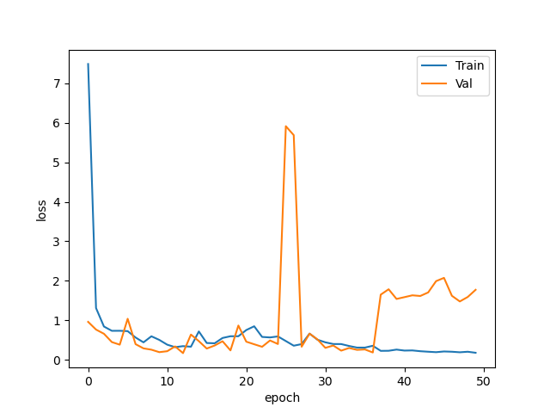
Our results: Loss

Slide 14
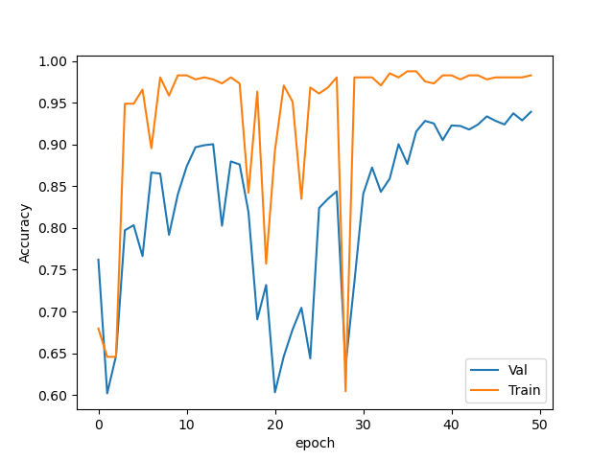
Our results: accuracy

Slide 15
Our results
When we evaluated the trained model on our testing dataset, we achieved a testing accuracy of approximately 93.9 % (F1 score of ~0.7)
There were large jumps in loss and accuracy, potentially due to overfitting on a specific feature and then reverting when the next batch found it inefficient

Slide 16
Possible Enhancement
For the model to improve its ability to recognize new data, there needs to be a tradeoff between training accuracy and generalization performance.
A progressive learning rate may help to account for jumps in accuracy and loss
While more dropout layers were tried and proved inefficient, low-level dropout between convolutional networks could provide some slight improvement

Slide 17
Outcome
During this project, we learned how to apply a dataset to a trained model, as well as ways to reduce data while maintaining a high level of resulting accuracy
Through testing different model architectures and parameters to improve performance, we gained a greater understanding of how specific layers impacted model training and operation
We realized slight changes in parameters used can have a drastic impact on how the model performs
We ran into, and had to attempt to combat, common issues such as convergence to a majority classification, a glitchy Palmetto cluster, and memory use issues when loading 3D image data and generating the models for it

Slide 18
Questions?

Slide 19
Thank you

